Slide 1
Building A Scalable And Adaptive Architecture (2)

Slide 2
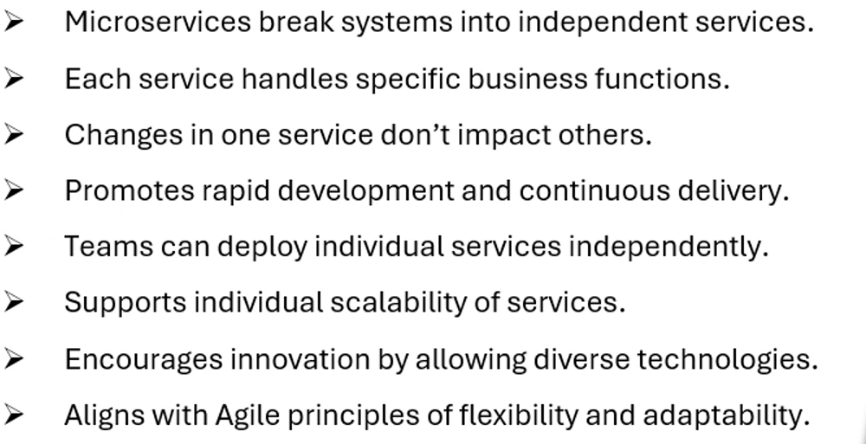
Microservices And Agile EA

Slide 3
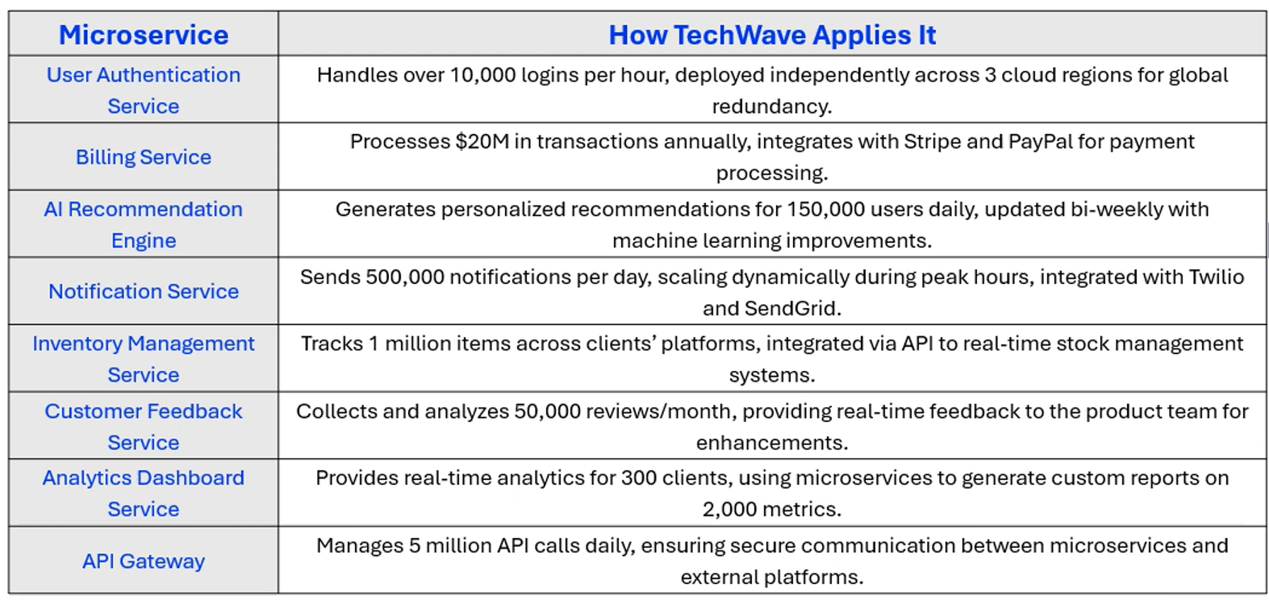
Microservices at Techwave

Slide 4
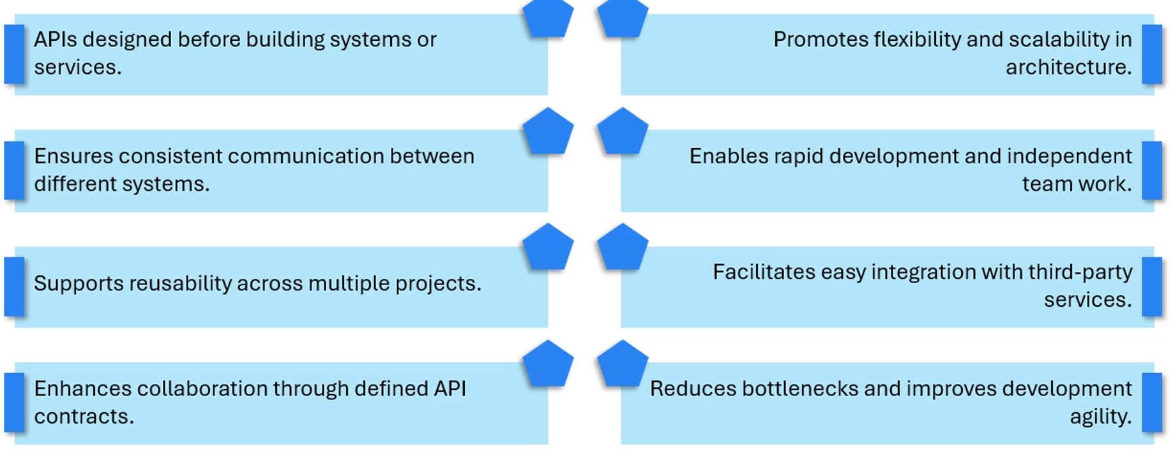
API-First Architecture

Slide 5
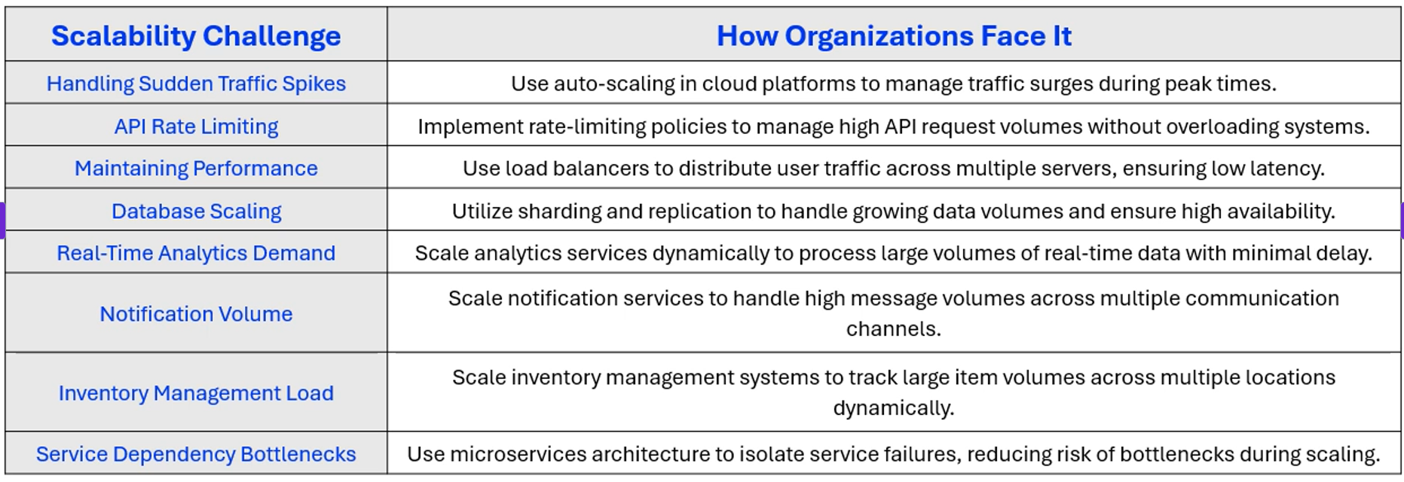
Scalability Challenges

